Slide 1
Assingment JavaWeb

Slide 2
Member
Trần Phạm Gia Bảo
Nguyễn Phạm Đăng Khoa
Lý Định Công Minh

Slide 3
Agenda
1.Case Study
2. Database Desgin
3. System Design
4. Demonstration
5. Conclusion

Slide 4
1. Case Study
Currently, there are many young people who need to study online to save time and money on online websites. Therefore, developing a system of online shop is essential to provide users with more choice and convenience in product selection , and this website gives you a better overview of online shopping and searching the product is suitable for you.

Slide 5
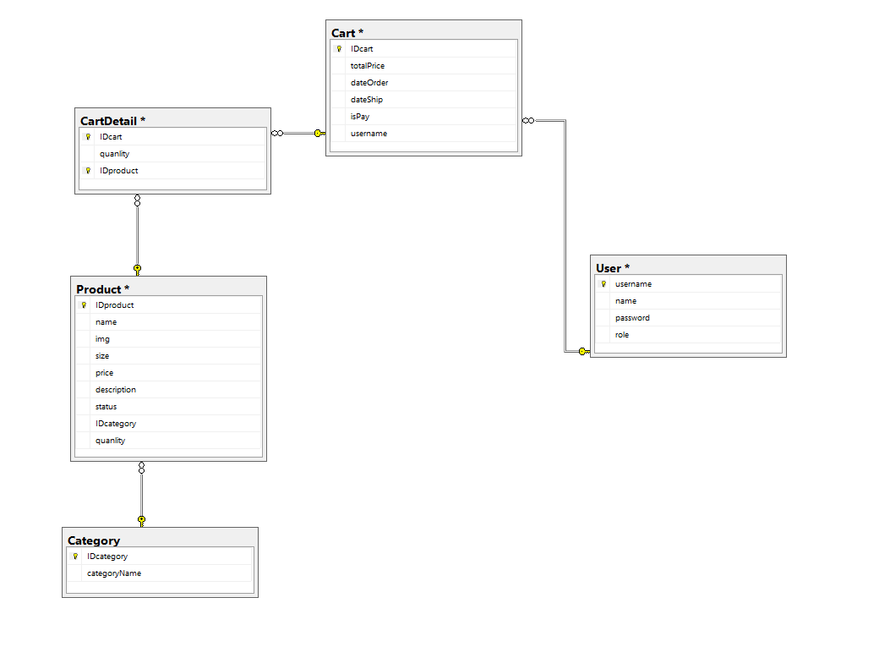
2. Database Design

Slide 6
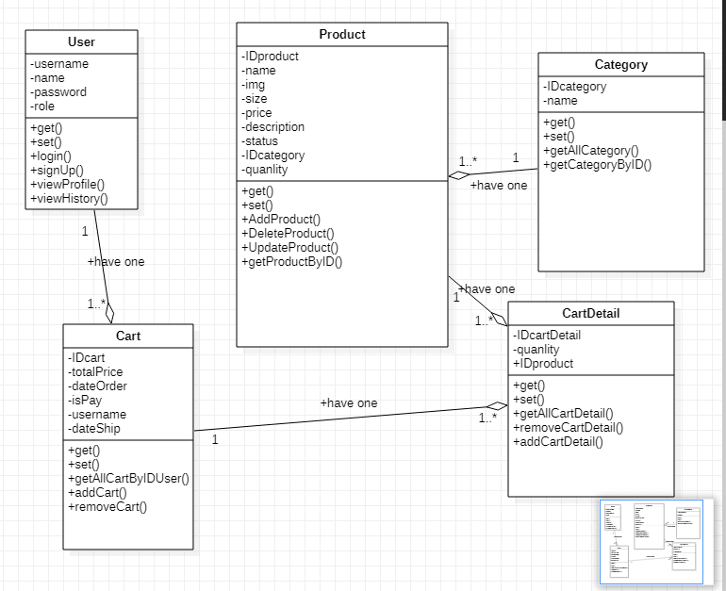
3. System Design

Slide 7
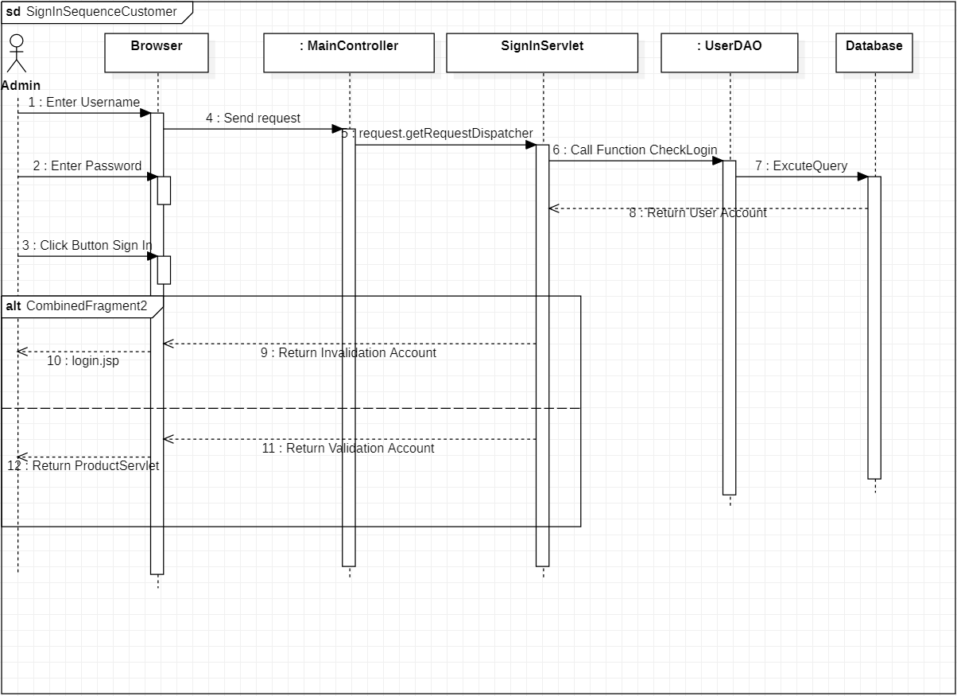
Sign In Customer

Slide 8
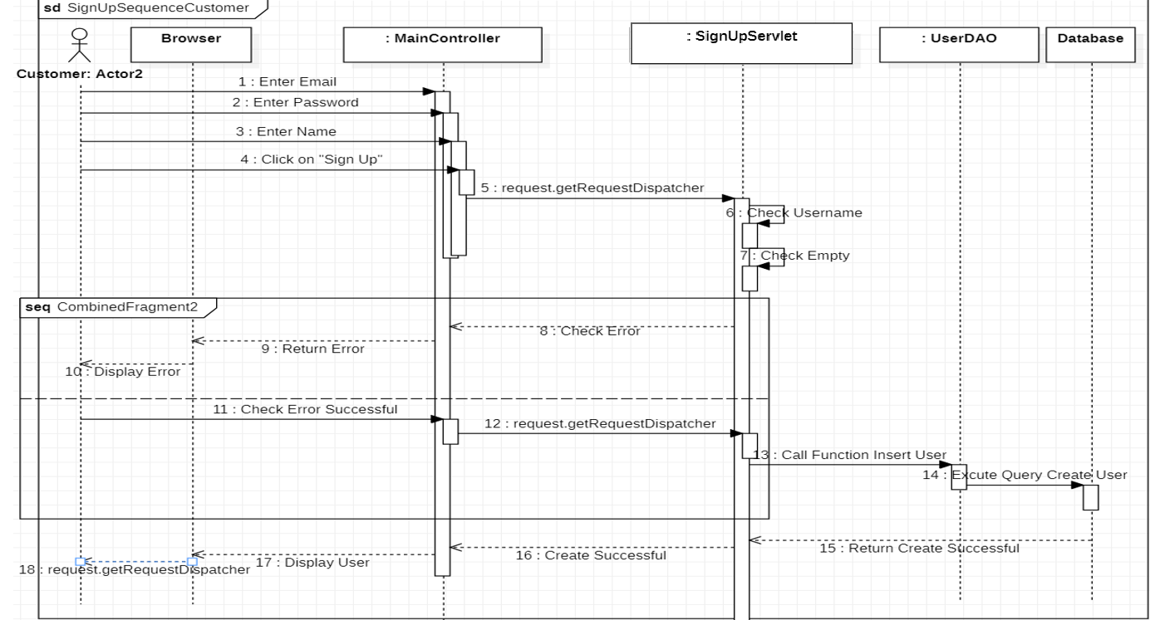
Sign Up Customer

Slide 9
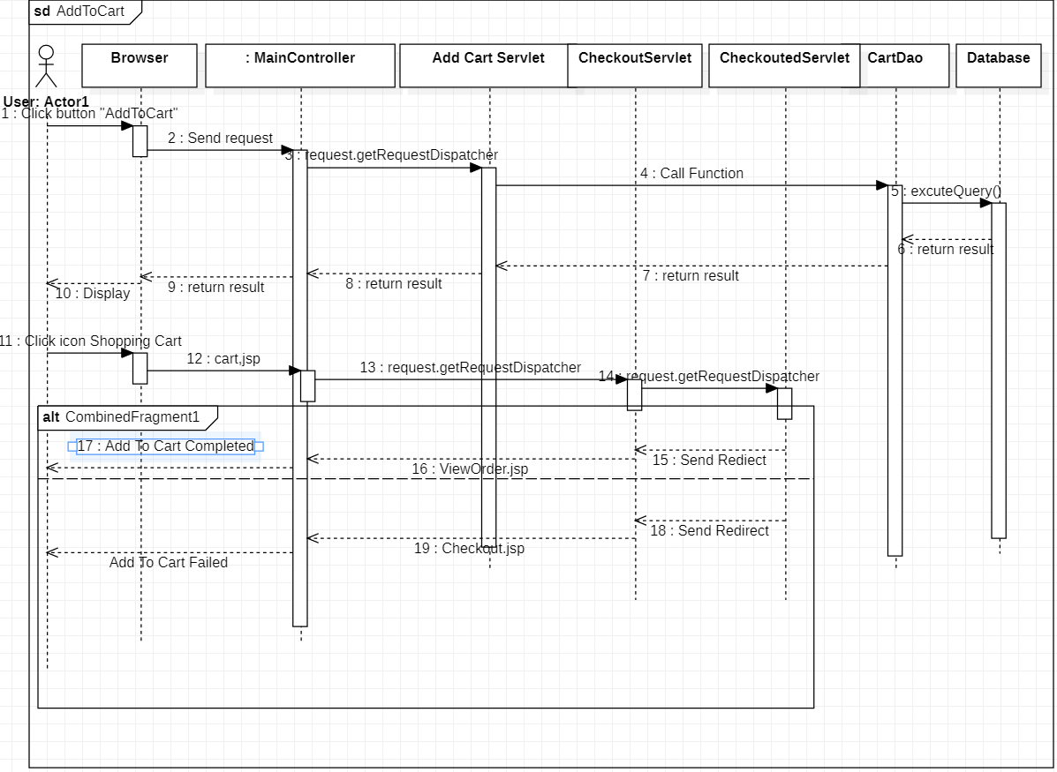
Add To Cart

Slide 10
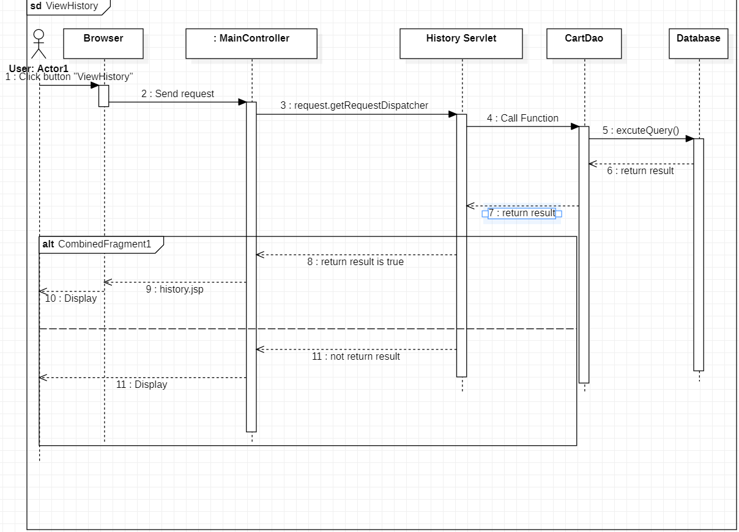
View History

Slide 11
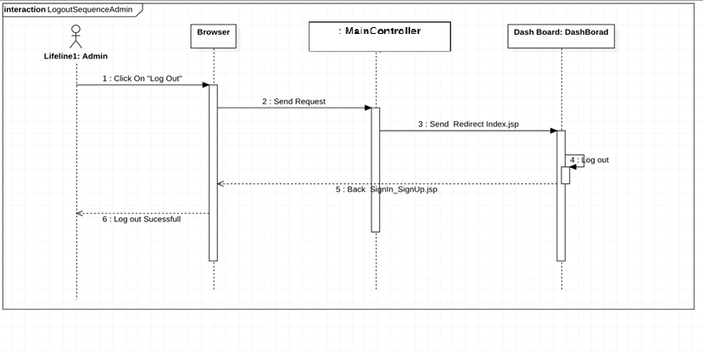
Logout Admin

Slide 12
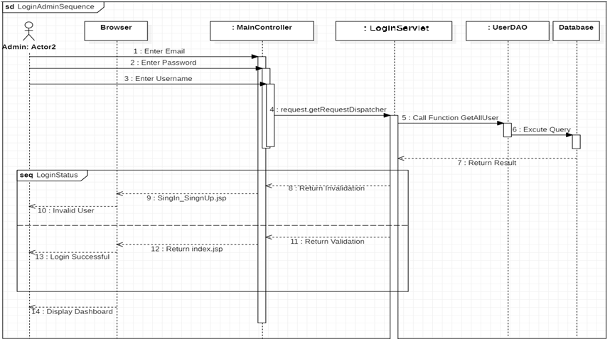
Login Admin

Slide 13
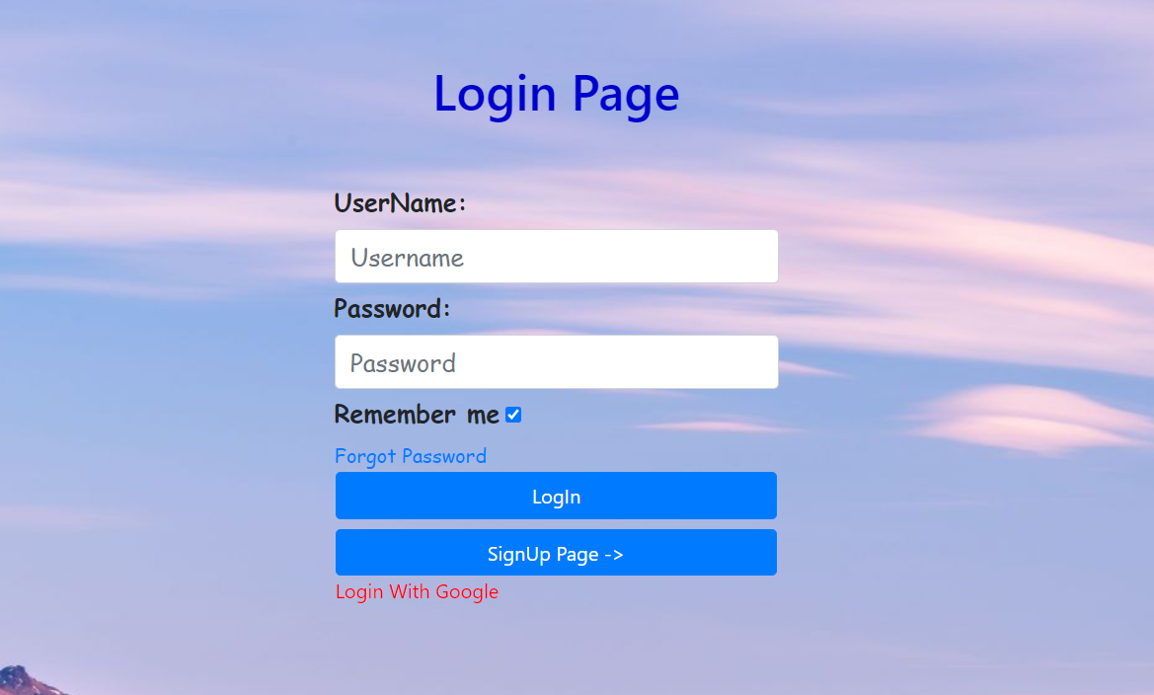
Login Page

Slide 14
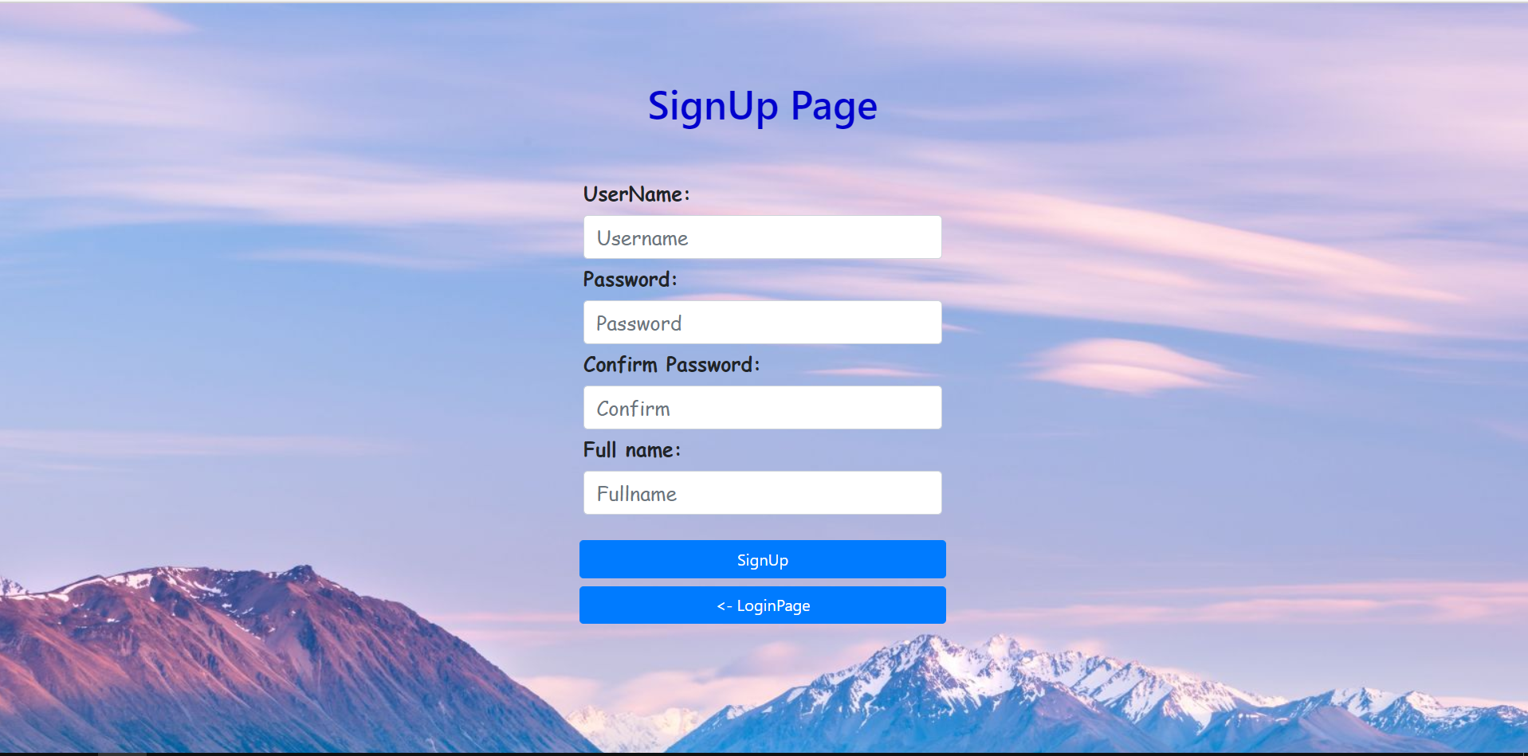
SignUp Page

Slide 15
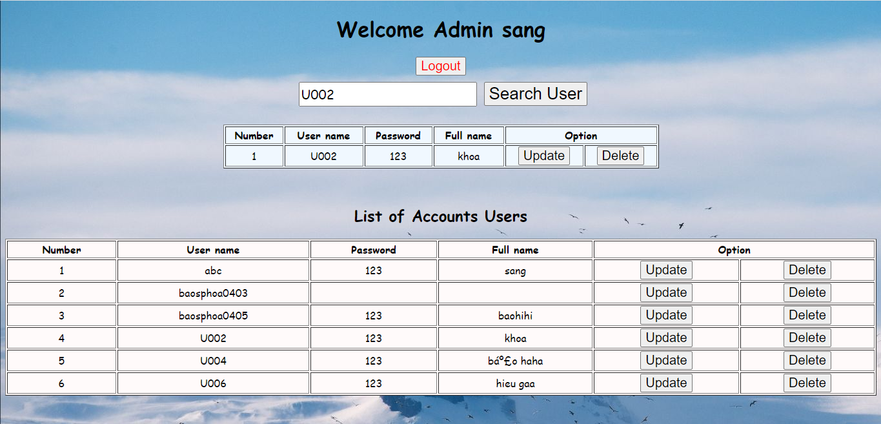
Manage User Form

Slide 16
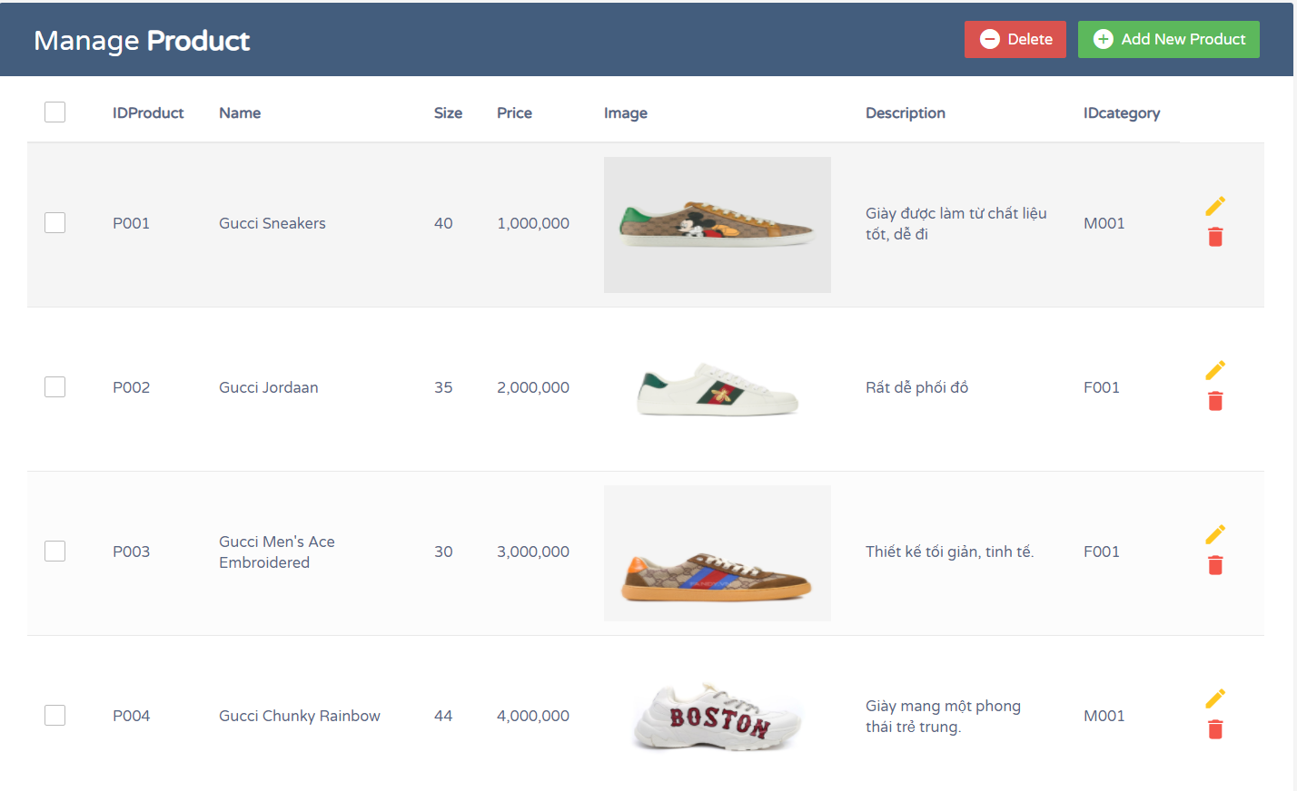
Manage Product Form

Slide 17
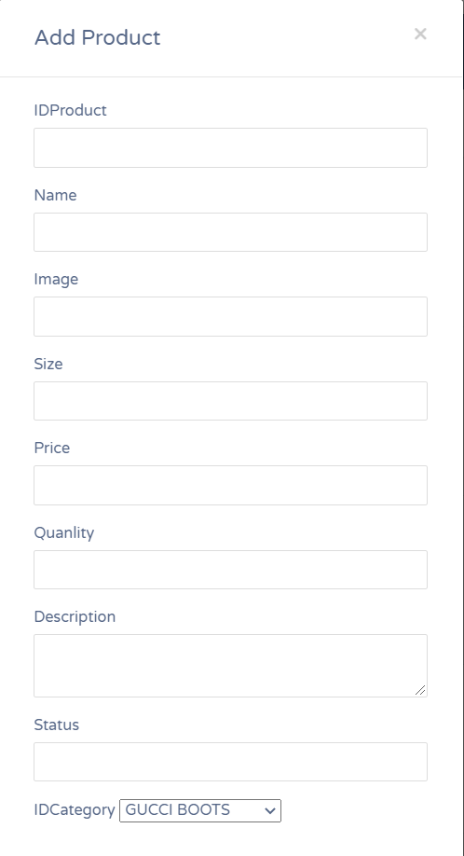

Add Product Form

Slide 18
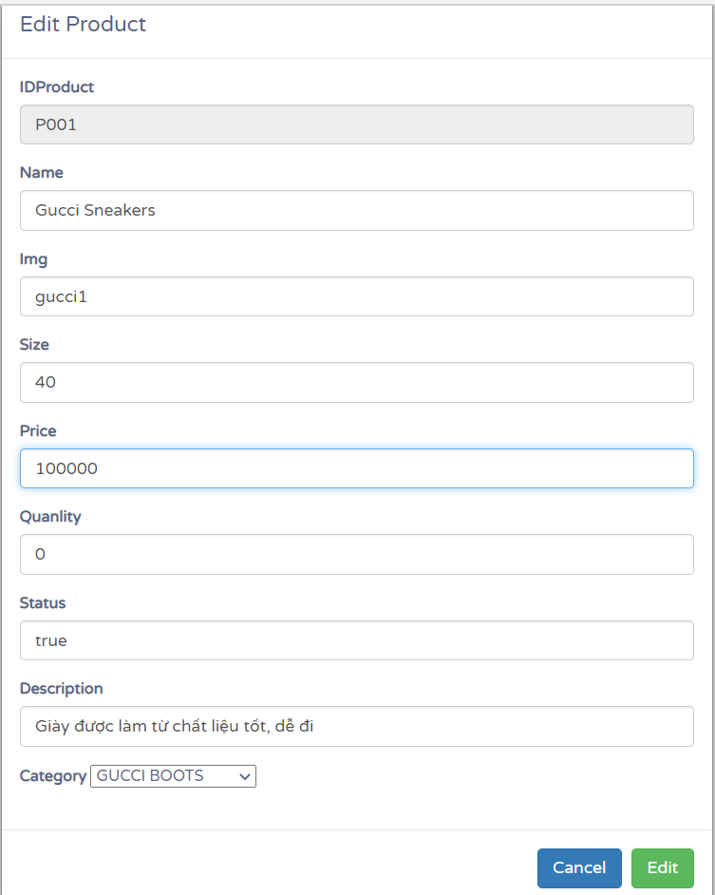
Edit Product Form

Slide 19
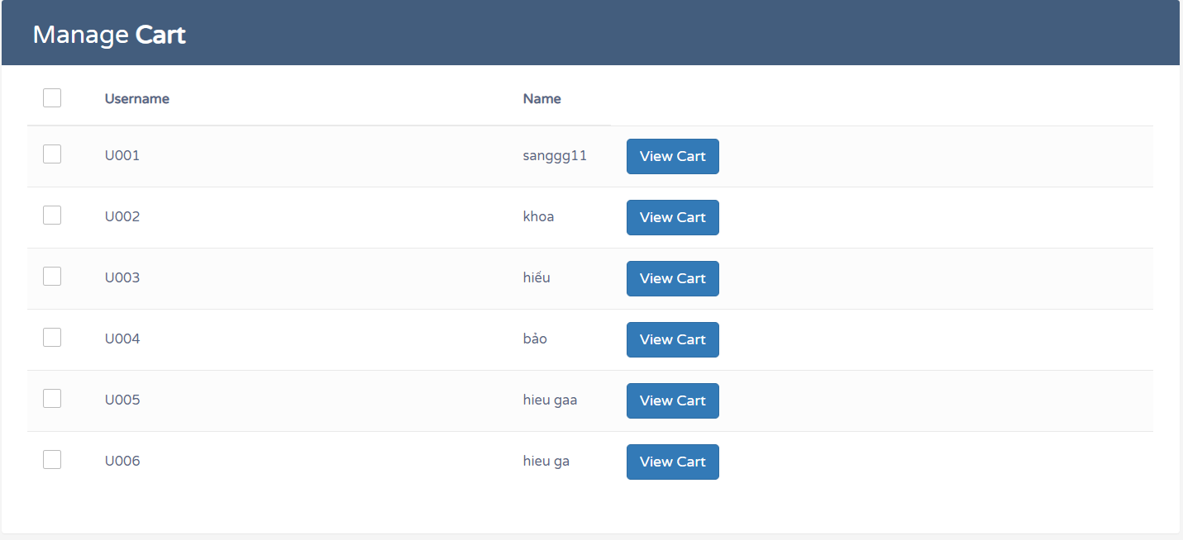
Manage Cart

Slide 20
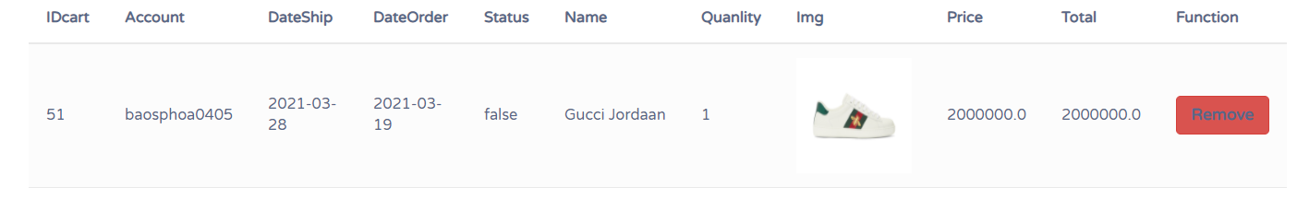
Remove Cart Form

Slide 21
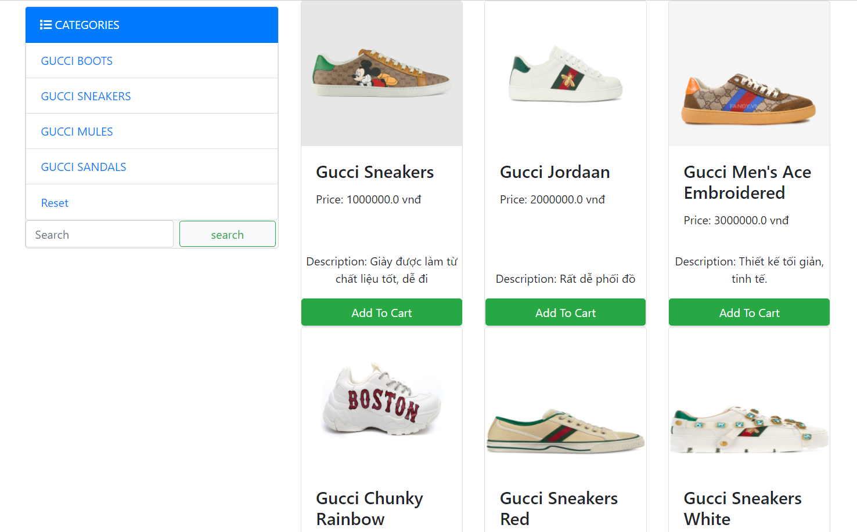
Customer’s Layout

Slide 22
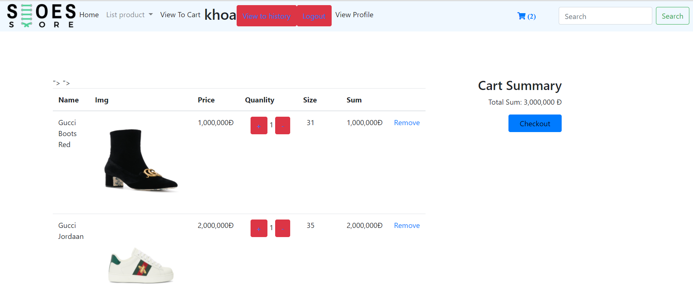
Add To Cart

Slide 23
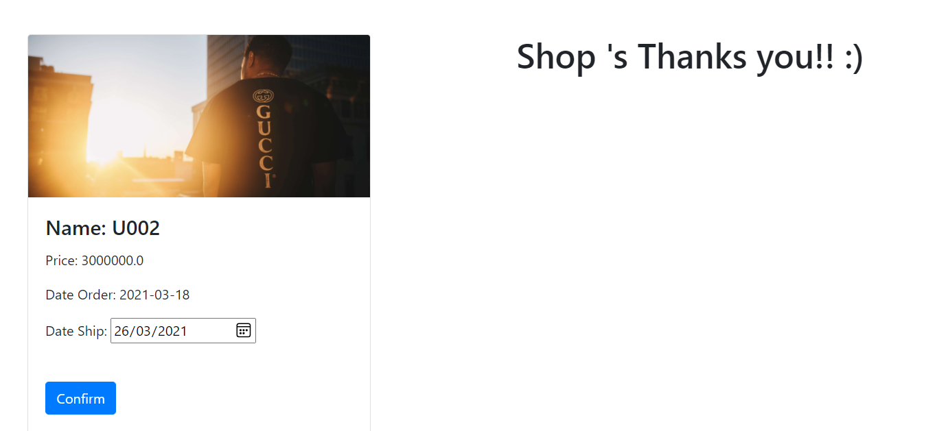
Confirm Order

Slide 24
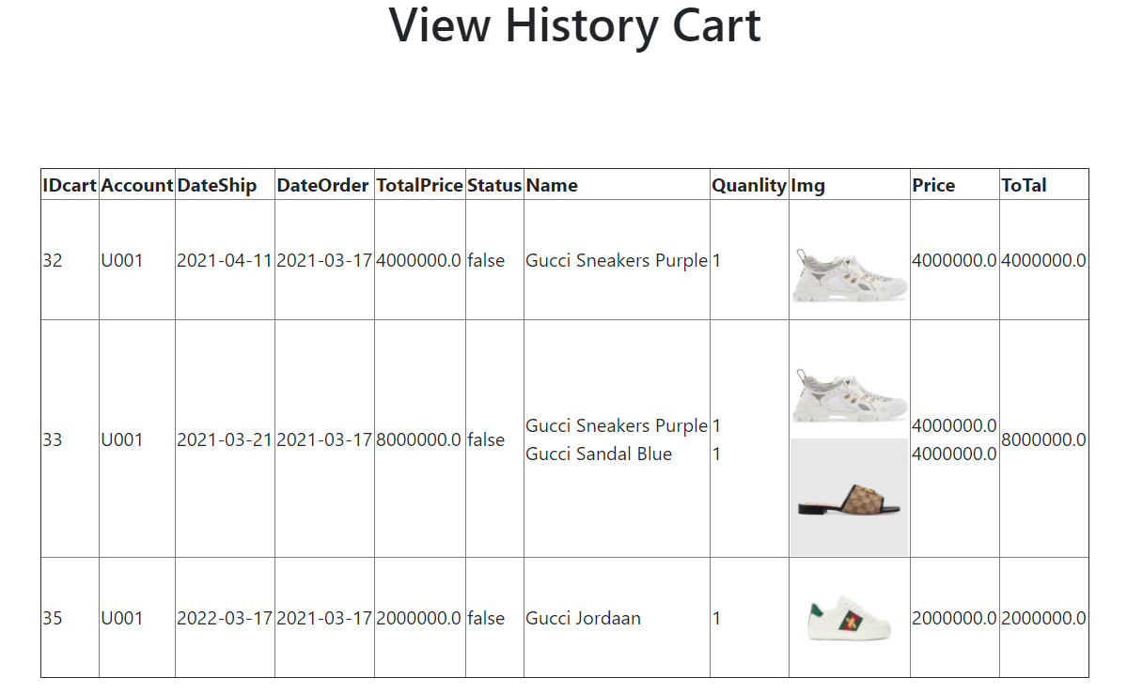
View History Cart

Slide 25

Thanks!
Any questions?

